Slide 1
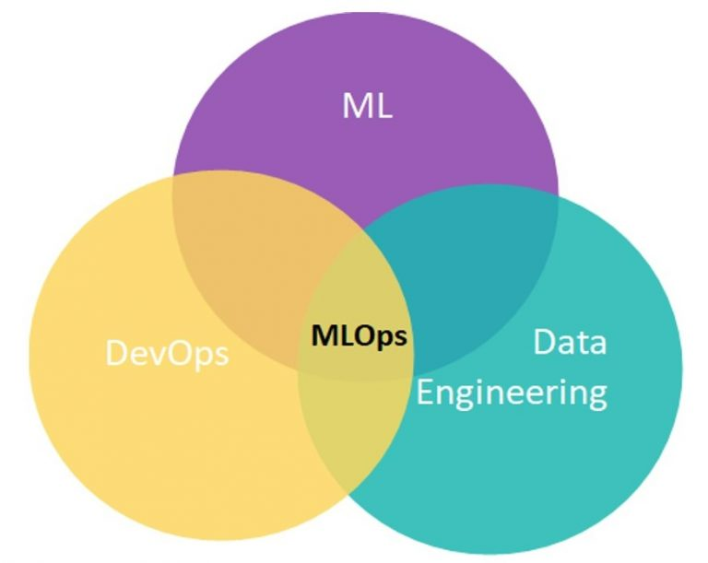
Introduction to MLOps

Slide 2
Prerequisites for MLOps
Programming: Proficiency in Python.
IDE: Familiarity with Visual Studio Code (VSCode).
Data Science & Machine Learning: Understanding of data science, machine learning concepts, and project life cycle.
Version Control: Knowledge of Git for versioning.
Containerization: Experience with Docker.
Orchestration: Familiarity with Kubernetes.
Cloud Platforms: Experience with AWS, Azure, or Google Cloud (GCS).

Slide 3
What is MLOps?
MLOps, short for Machine Learning Operations, is a practice that combines machine learning (ML) with DevOps principles to streamline and automate the process of deploying, managing, and monitoring ML models in production environments. Here’s a beginner-friendly definition:
MLOps is the set of practices and tools that help data scientists and IT teams collaborate to develop, deploy, and maintain machine learning models efficiently and reliably. It focuses on automating repetitive tasks, ensuring model performance, and enabling continuous integration and delivery of ML models.
Key aspects of MLOps include:
Automation: Automating the ML pipeline, from data preparation to model deployment.
Collaboration: Bridging the gap between data science and IT operations teams.
Monitoring: Continuously monitoring model performance to detect and address issues.
By applying MLOps, organizations can improve the scalability, reliability, and efficiency of their machine learning workflows.

Slide 4
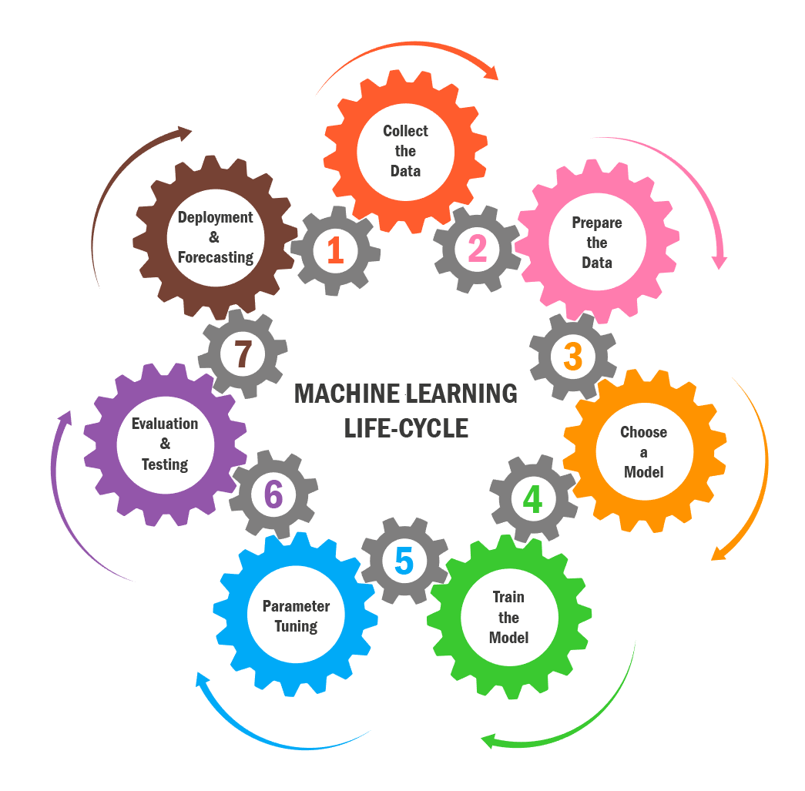
Machine Learning Life cycle

Slide 5
Challenges in the Traditional Machine Learning Lifecycle
1. Low Coding Standards
Lack of OOPs: Absence of object-oriented programming principles.
No Modular Coding: Code is not broken down into reusable modules.
Poor Logging: Insufficient logging for debugging and monitoring.
No Exception Handling: Lack of proper error handling mechanisms.
2. No Data Management
Data Ingestion: Inefficient methods for collecting and processing data.
Artifacts Management: Poor management of data artifacts and versions.
3. No Versioning
Code Versioning: Absence of version control for code changes.
Model Versioning: No tracking of different versions of ML models.

Slide 6
Challenges in the Traditional Machine Learning Lifecycle
4. Data Pipeline/Experiments
Pipeline Management: Lack of structured data pipelines for experiments.
Experiment Tracking: No systematic way to track and compare experiments.
5. No CI/CD Concept
Continuous Integration: No automated integration of code changes.
Continuous Deployment: Lack of automated deployment processes.
6. Scalability and Monitoring
Scalability Issues: Difficulty in scaling models and infrastructure.
Monitoring: Inadequate monitoring of model performance and health.
7. Cross-Team Friction
Collaboration: Poor collaboration between data scientists and IT/DevOps teams.
Communication: Miscommunication and lack of shared understanding.

Slide 7
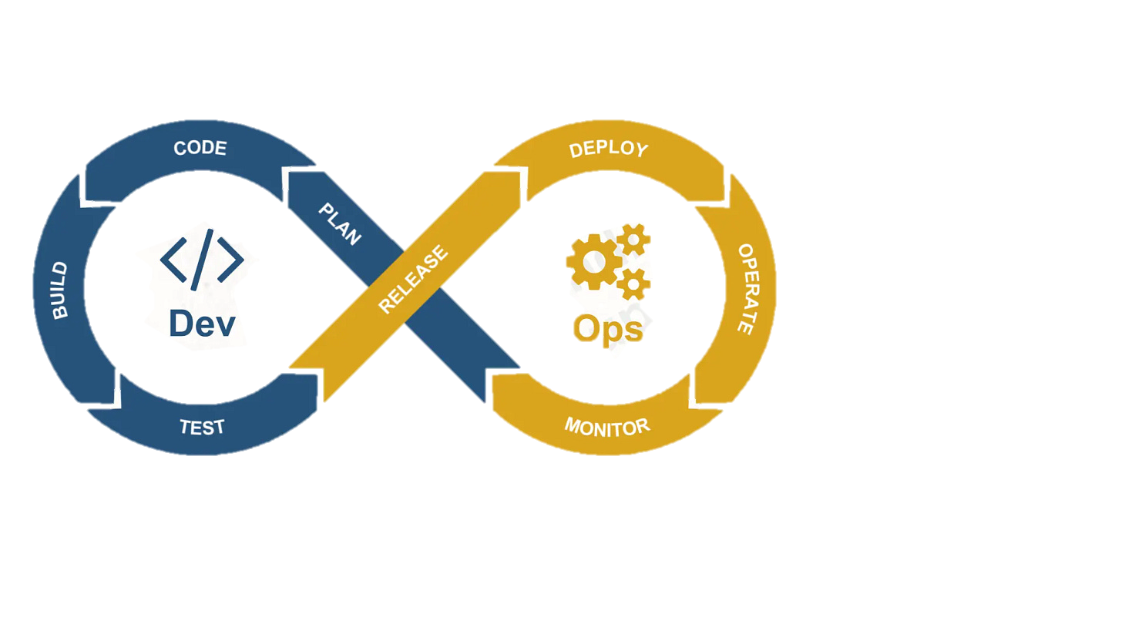
DEV + Ops=DevOps
Dev (Development):
Plan: Defining project goals and requirements.
Code: Writing and maintaining code.
Build: Compiling and building the software.
Test: Testing the software to ensure quality.
Ops (Operations):
Release: Preparing the software for deployment.
Deploy: Deploying the software to production.
Operate: Running and managing the software in production.
Monitor: Continuously monitoring the software for performance and issues.

Slide 8
ML+DevOps=MLOps
ML (Machine Learning):
Devops
Data Preparation: Collecting and preprocessing data.
Model Training: Developing and training machine learning models.
Model Evaluation: Assessing model performance.

Slide 9
Key Learning Areas in MLOps
Code Standards
OOP Concepts: Understanding object-oriented programming principles.
Modular Coding: Writing reusable and maintainable code modules.
Logging: Implementing logging for better debugging and monitoring.
Managing Artifacts and Components
Artifacts Management: Efficiently managing data artifacts and components.
Pipeline Management: Creating and maintaining data pipelines.
Code Versioning
Git/GitHub: Using Git and GitHub for version control of code and collaboration.
Data/Model Versioning
DVC: Data version control for managing datasets.
MLflow: Tracking and managing different versions of machine learning models.
Maintaining Data Pipeline and Experiments
DVC: Managing data pipelines and versioning datasets.
MLflow: Tracking experiments and model versions.

Slide 10
Key Learning Areas in MLOps
CI/CD
GitHub Actions: Automating continuous integration and continuous deployment processes.
Containerization
Docker: Creating and managing containers for consistent environments.
Docker Hub: Storing and sharing container images.
Scalability and Monitoring
Kubernetes: Orchestrating and scaling containerized applications.
Monitoring Tools: Tools for monitoring model performance and infrastructure.
AWS Services
IAM: Managing access and permissions.
ECR: Storing and managing Docker container images.
S3: Storing and retrieving data.
EC2: Running virtual servers in the cloud.

Slide 11
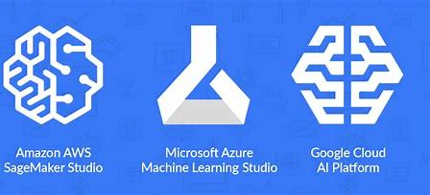
All-in-One Services
AWS SageMaker: Comprehensive service for building, training, and deploying ML models.
Azure ML: End-to-end machine learning service for building and deploying models.
Google Vertex AI: Fully-managed, unified AI development platform for training, deploying, and managing ML models

